Slide 1
Project
Dr. S.RadhaKrishnan Team
The
By-
Ayesha
Rishvanth
Surya
Jignesh
Veeraju

Slide 2

Talend
Data Integration tool

Slide 3
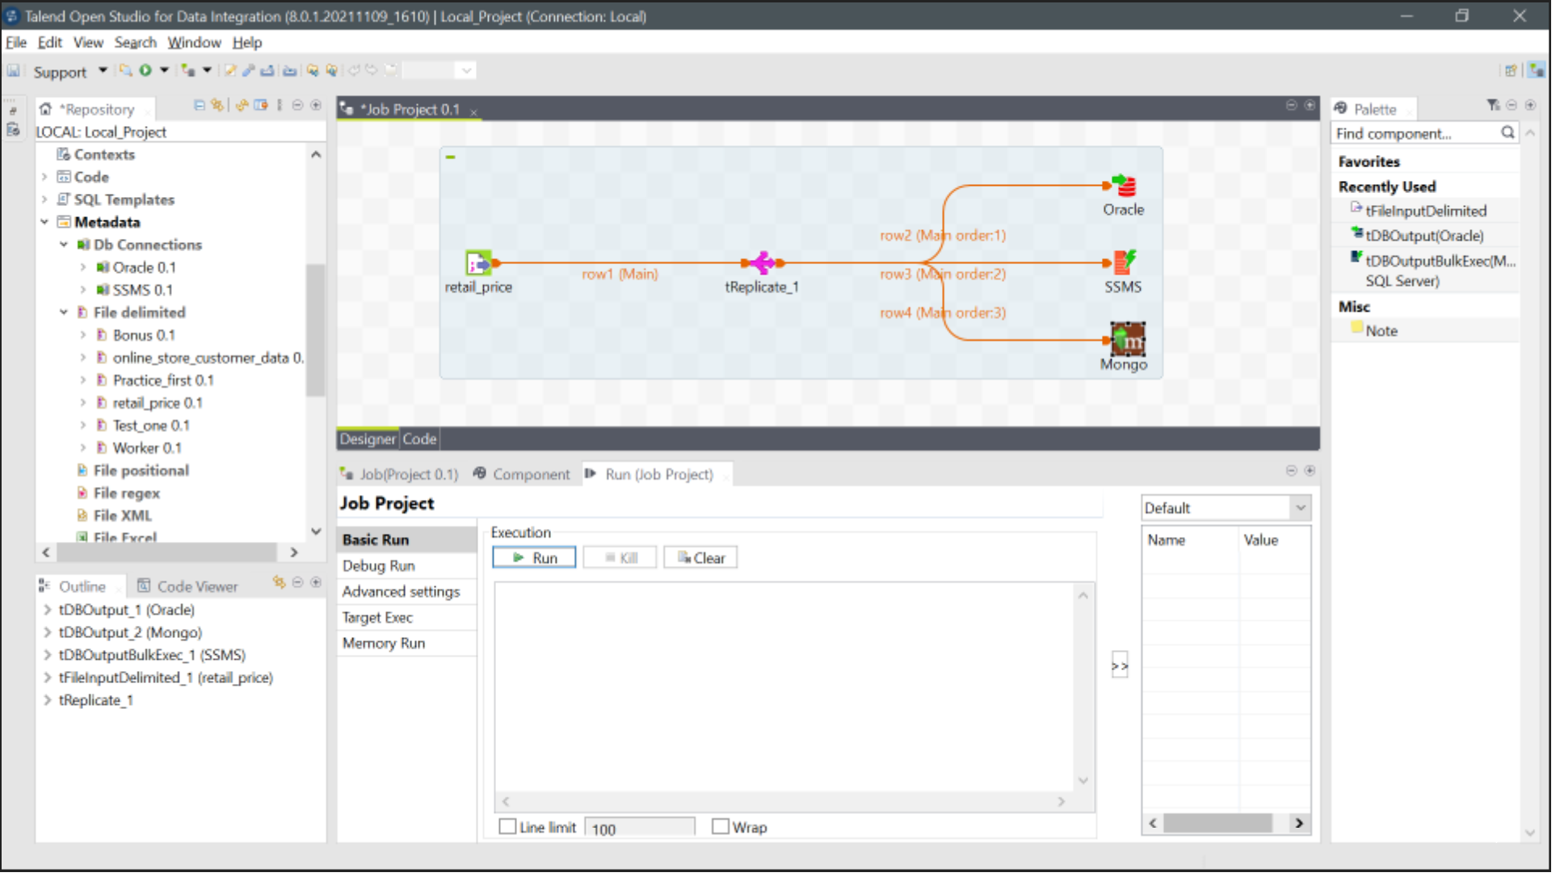
Retail_price

Slide 4


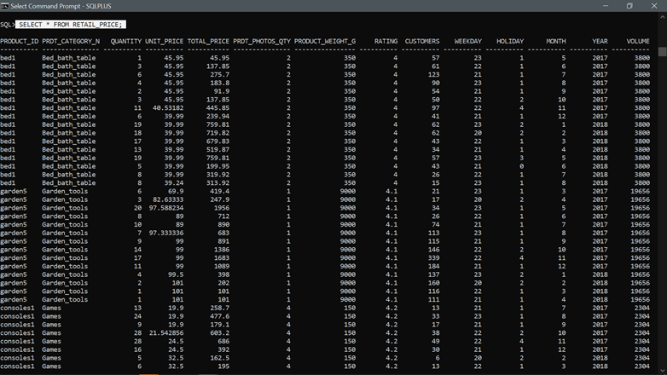
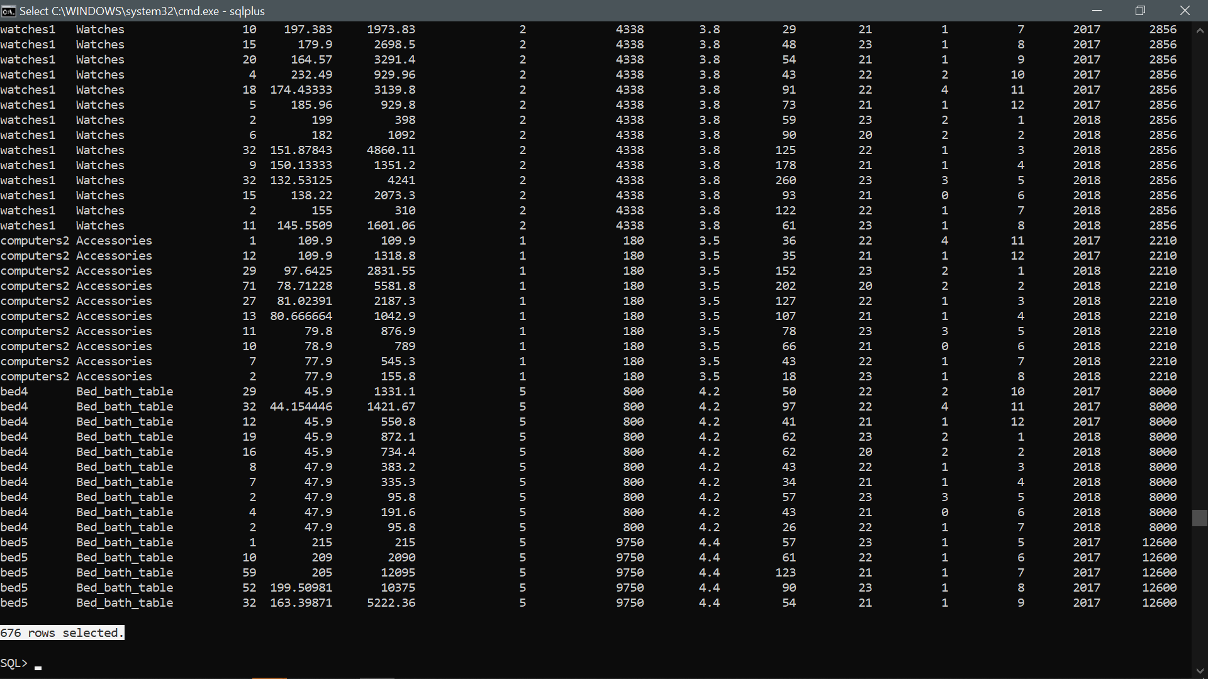
SQL
SELECT * FROM RETAIL_PRICE;

Slide 5

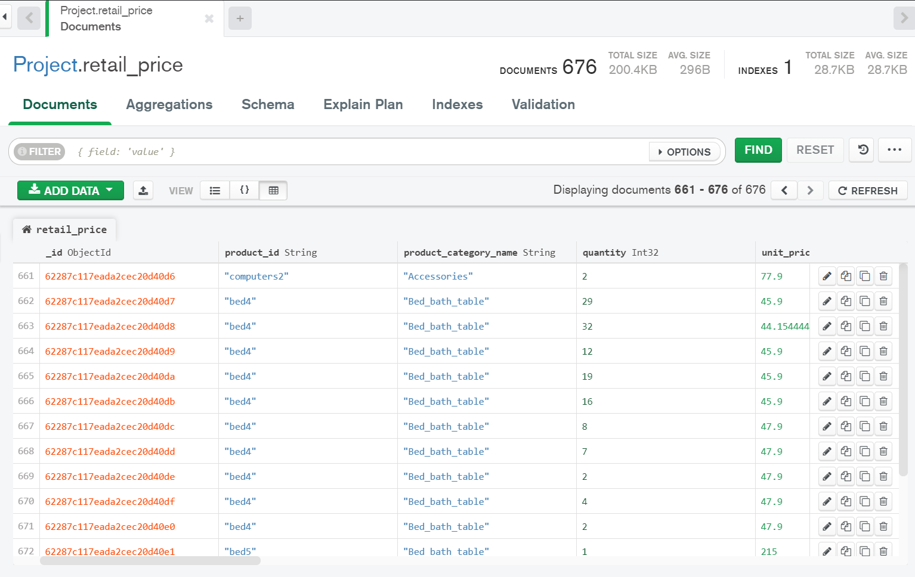
db. retail_price.find()
Mongo db

Slide 6

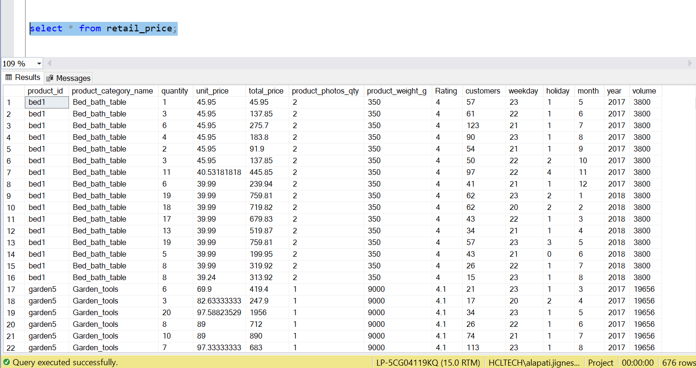
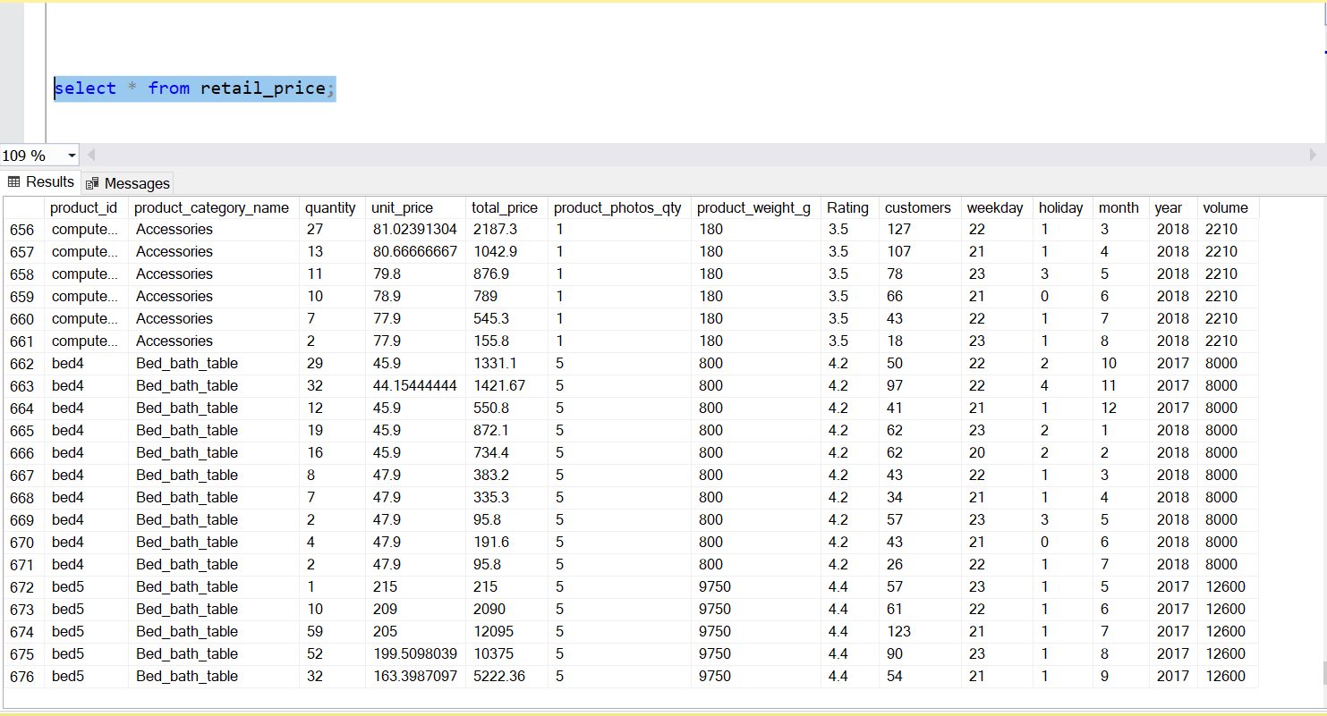
SSMS
select * from retail_price;

Slide 7

Tableau
Business Intelligence Tool

Slide 8
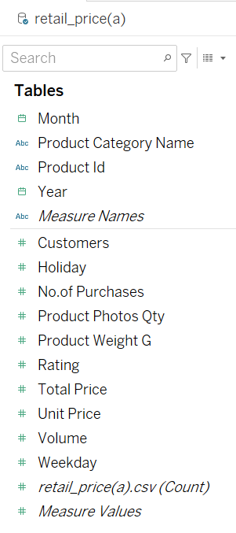

Retail Price

Slide 9
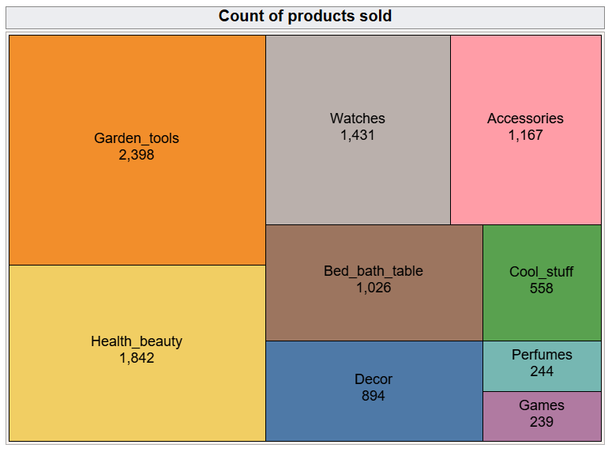
Report – 1

Slide 10


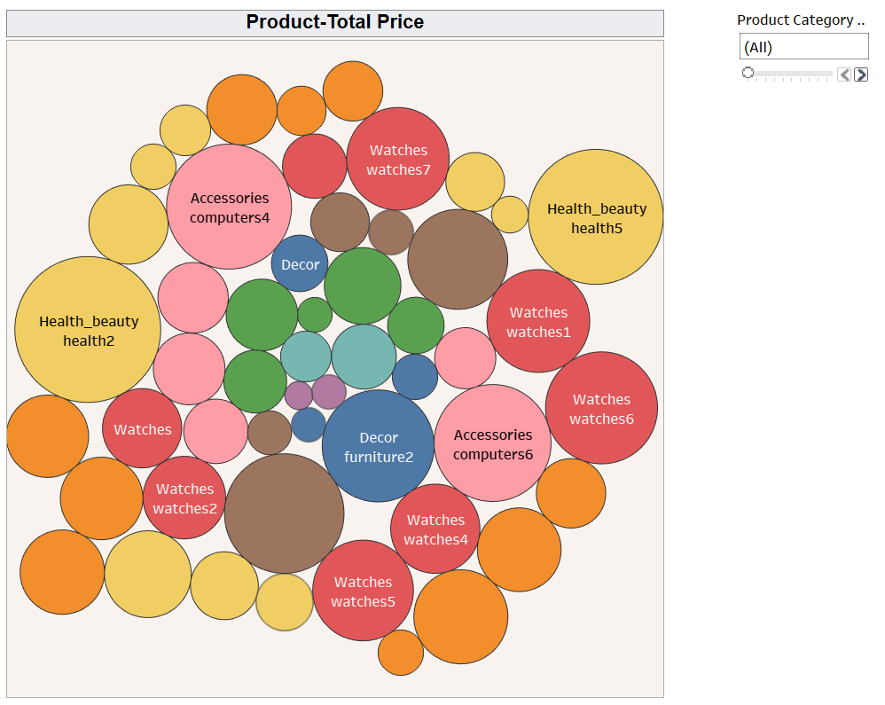







Report – 2

Slide 11


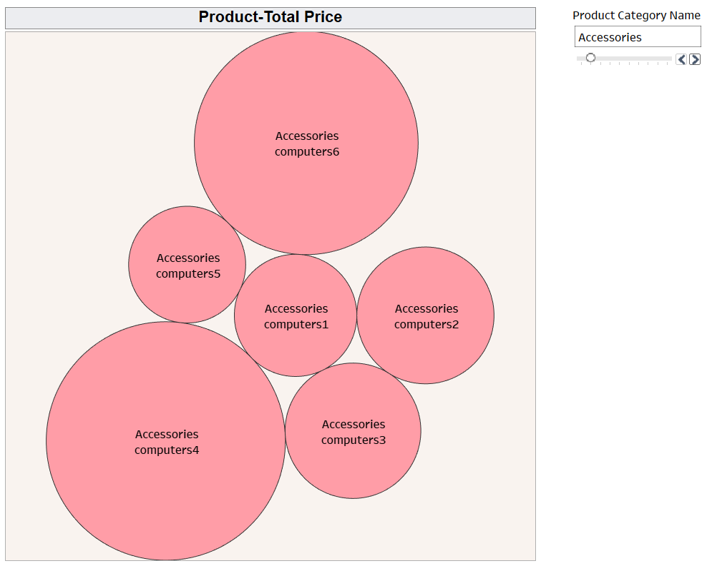
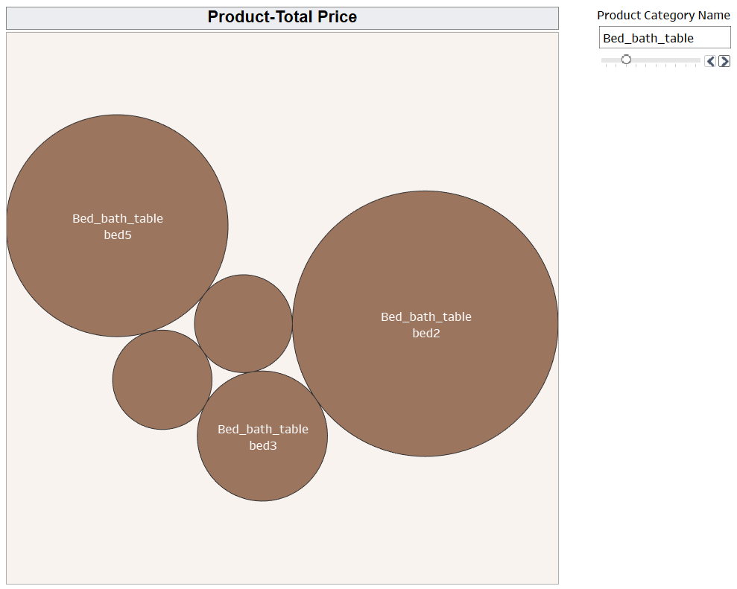
Accessories
Bed bath table

Slide 12


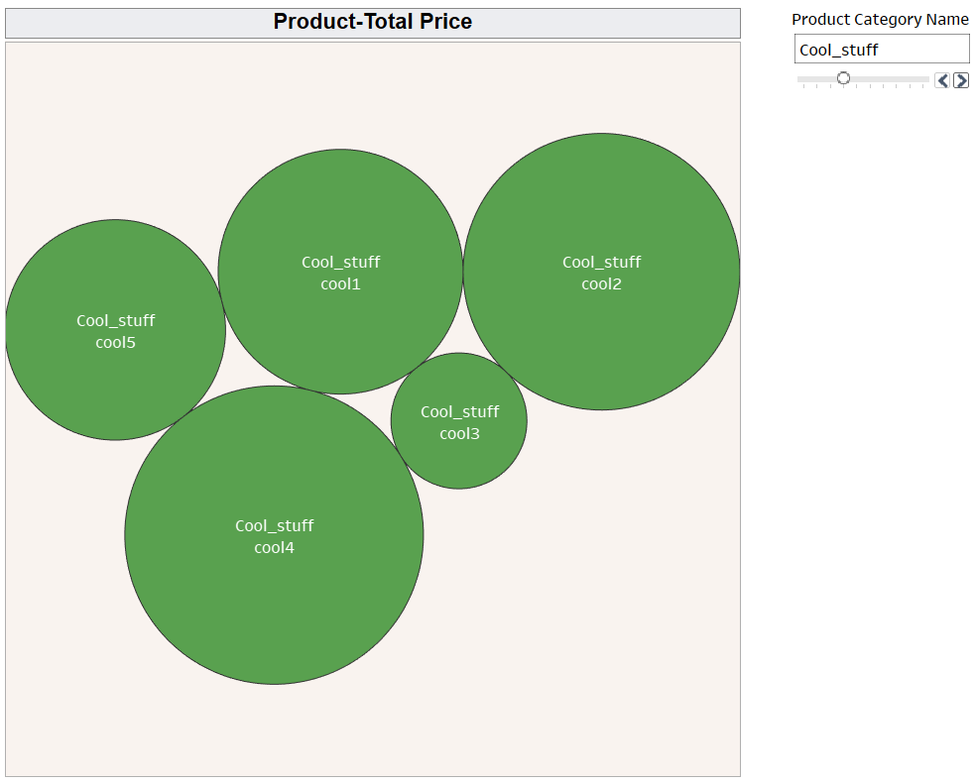
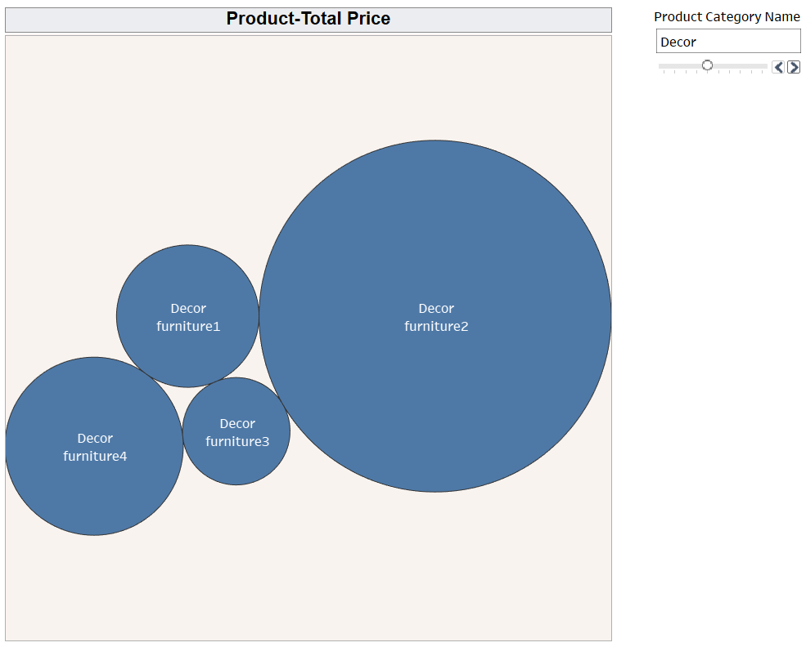
Cool stuff
Decor

Slide 13


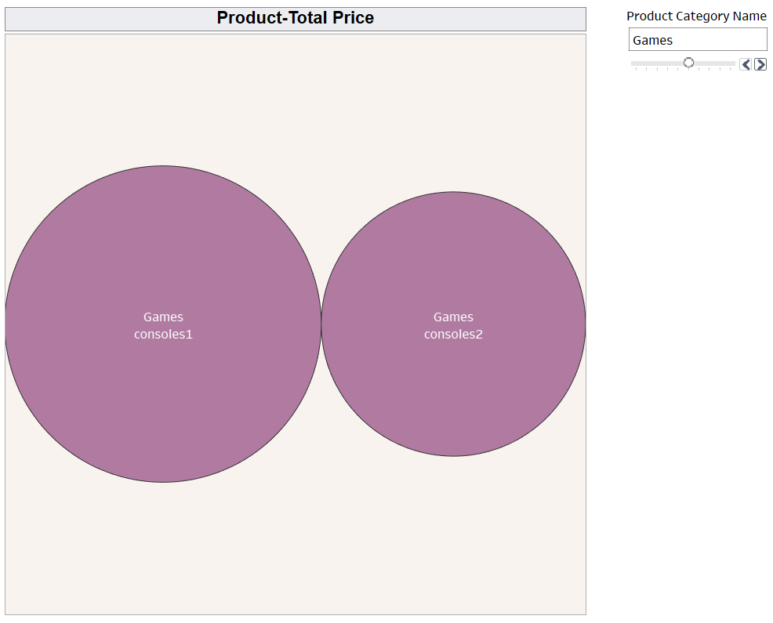
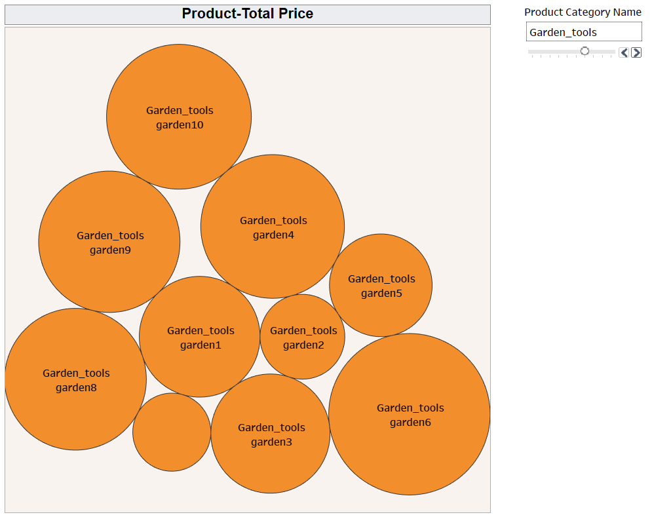
Games
Garden tools

Slide 14


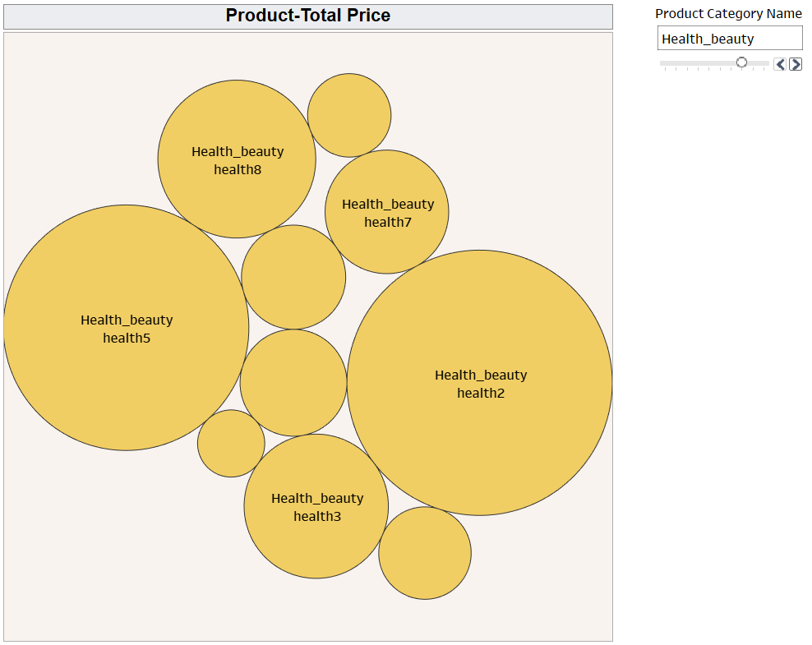
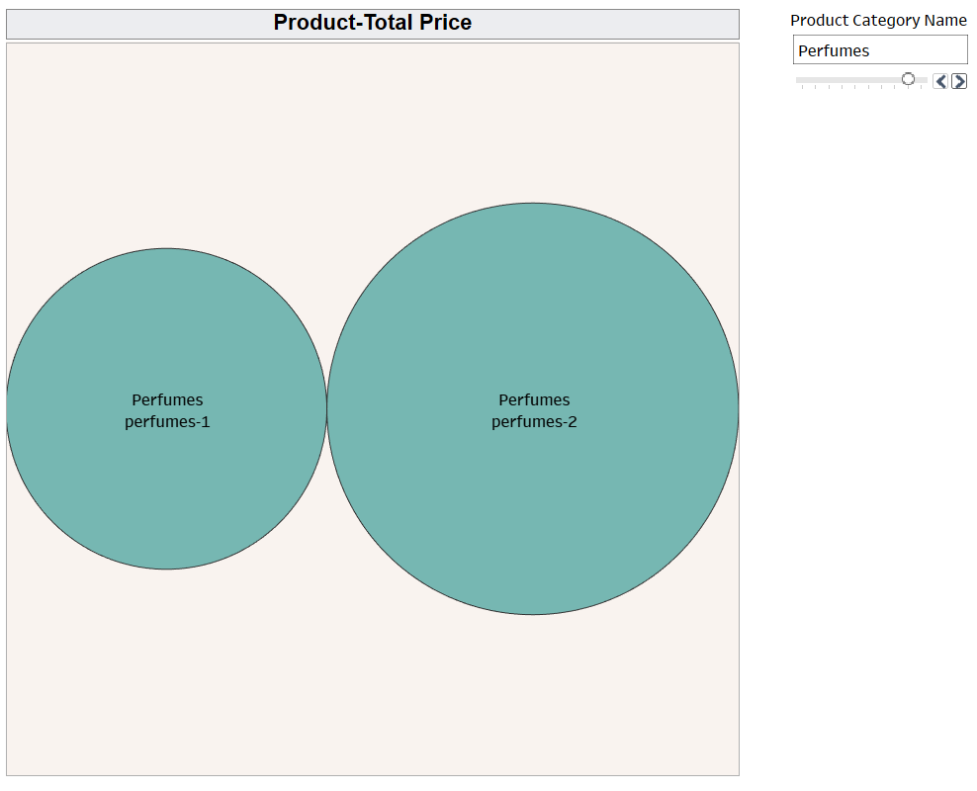
Perfumes
Health beauty

Slide 15

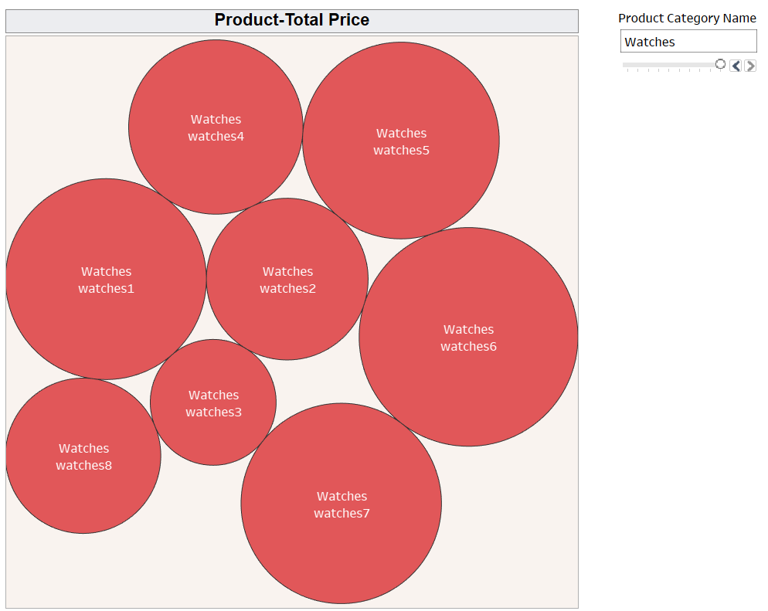
Watches

Slide 16
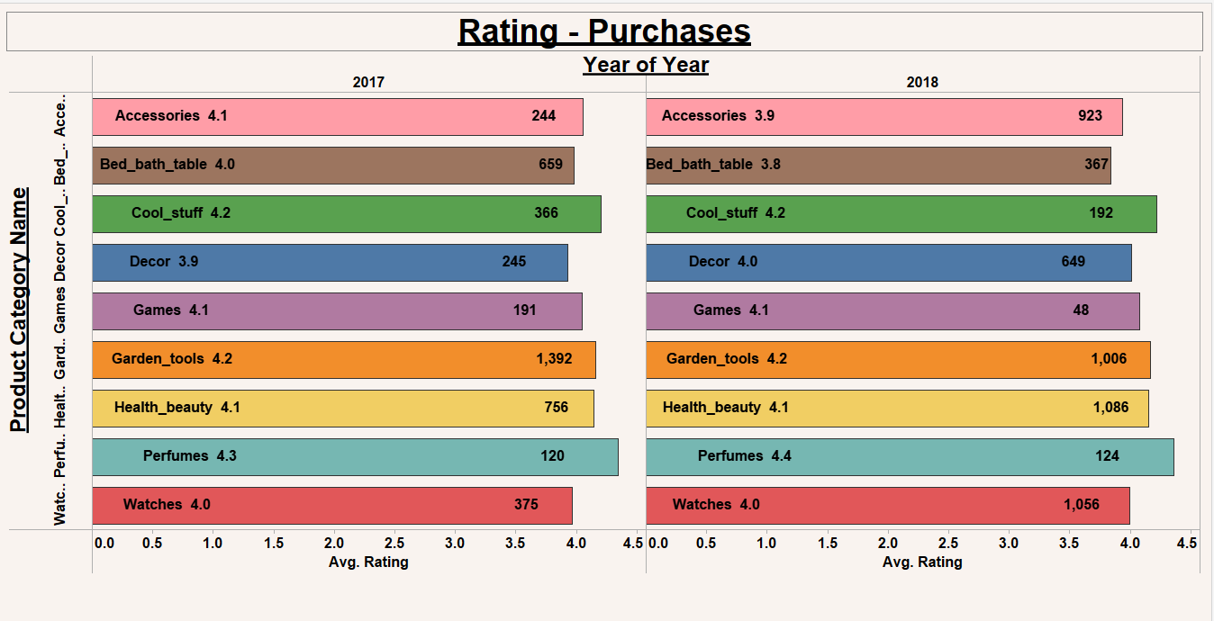
Report – 3

Slide 17
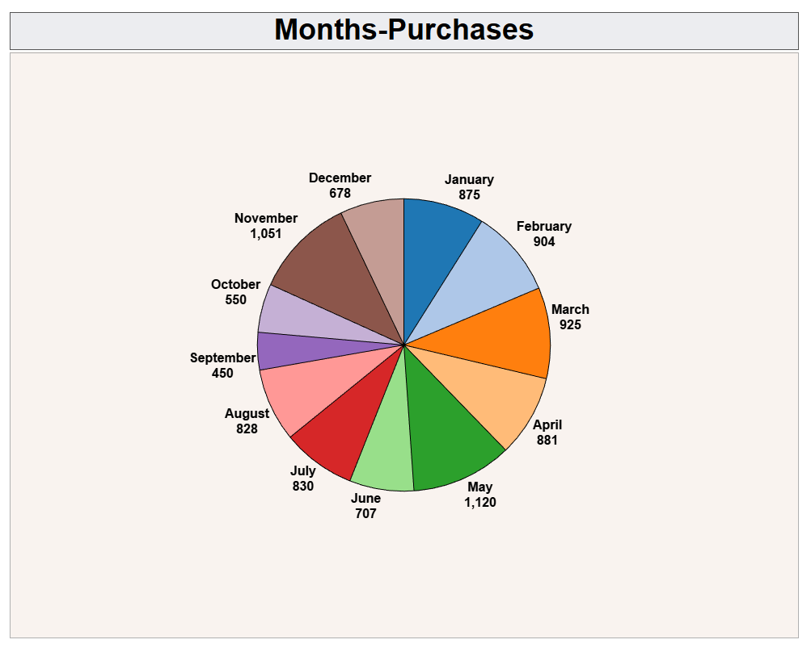
Report – 4

Slide 18

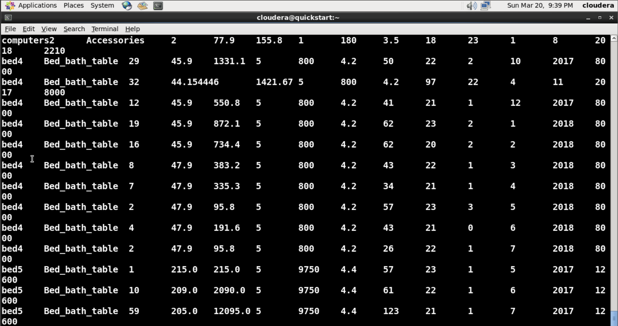
select * from retail_price
Hive

Slide 19
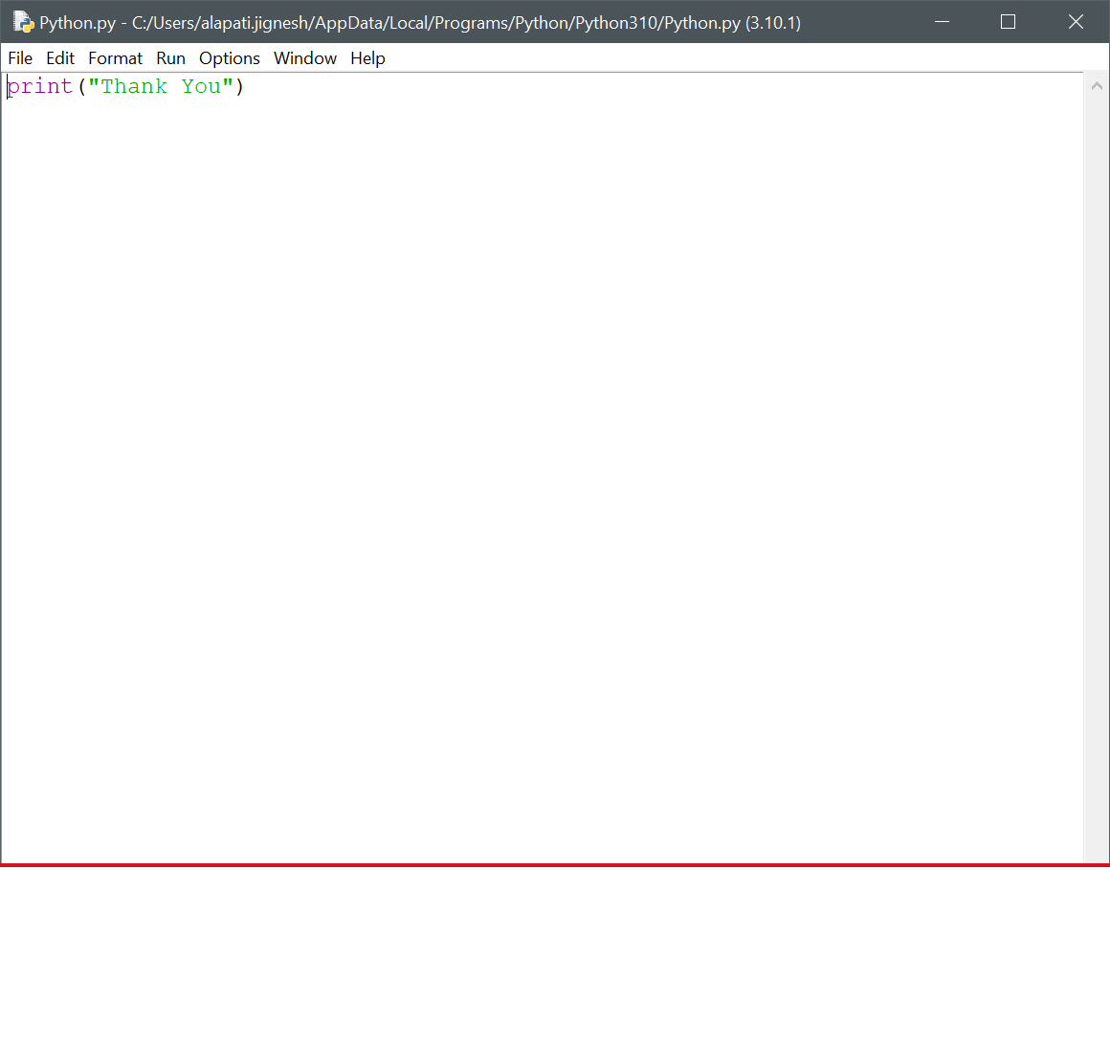
Thank You

